Slide 1

October 2025

Slide 2

Building & Development​
November 2025 Development
Zoning Board of Adjustment on 11/18/2025
Building Official Robert Decker had attended the BPAT in October
Tree & Landscape on 11/6/2025
Planning and Zoning on 11/17/2025
One Pre-development meeting
Permit Tech Christella Hernandez will attend a Permit Tech Class 11/10-12/2025
2

Slide 3

Permitting & Inspections –October 2025
Inspections: 342
Permits Issued: 120
Permit Fees Collected: $38,982.90
Impact Fees Collected: $27,660.73

Slide 4

DEVELOPMENT
Active Developments inside city
limits: as of 10-31-2025
Kokomo Subdivision, 2202 FM 3036: SFD Subdivision with 40 lots;
Phase 6 infrastructure completed
Pearl Street Square, 1802 FM 2165 – 37 R1 SFD Lots with 2 R7 Lots:
Infrastructure being installed and lift station being upsized to also serve other developments in the area.
Lakeway Estates Phase I Final Plat – 88 SFD Lots
Tree mitigation approved for Phase I; Phase I Final Plat scheduled to go before P&Z 11/17/2025;construction documents under review
Daniels Forest Subdivision – 116 Forest Hills – 20 SFD Lots - Tree Mitigation approved July 2024- Final Plat approved November 4, 2024,–construction documents under review
Oasis - PUD 2101-2121 FM 3036 – PUD approved January 2025 – Construction plans under review
Active Developments inside city
limits: as of 10-31-2025
The Palms 349-499 SH 35 Bypass – Final Plat approved in April 2025-CUP for an RV and Tiny Home Resort approved in August 2025 - waiting for tree mitigation and construction plans.​
The Oaks at Market Street – 802 W Morgan & 155 Kelly Lane – SFD Subdivision with 163 Lots – Part in City Limits / Part outside City Limits – Rezone request for R2 scheduled to go before P&Z on 11/17/2025 and Council on 12/9/2025 – Annexation of lot outside city limits in process​
Village by the Bay – Railroad Reserve on S Ann St - 13.519 acres SFD Subdivision – Development still in discussion; Rezone request for R2 scheduled to go before P&Z on 11/17/2025 and Council on 12/9/2025​
Passport Shores – 3760 Hwy 35 S – 54.555 acres - SFD Subdivision – no submittals as of this date – Development Agreement under review​
The Highlands – 1859 FM 2165 – 35.81 acres - SFD Subdivision with 115 lots – Rezone to R2 approved in March 2025 – no submittals as of this date

Slide 5

DEVELOPMENT
Active Developments outside city
limits: as of 10-31-2025
Park Place, Fulton, Texas – RV Resort with 101 spaces in the Town of Fulton but utilizing the City of Rockport water service – Development agreement
Silverleaf – SFD Subdivision – 156 SFD Lots – utilizing city water and wastewater services – Lift Station plans under review – Development Agreement
Commercial projects:
as of 10-31-2025
RFISD Bond Projects 1603 Pirate Dr - Construction ongoing – rough ins approved – waiting for finals
Blue Wave Car Wash 2000 Hwy 35 N – Tree Mitigation approved - Construction ongoing – meter release approved
Dunkin Donuts @ Walmart 2401 Hwy 35 N –Construction ongoing
UHAUL 3591 SH 35 Bypass – Tree mitigation and landscape plan reviewed by T&L Committee 11/6/2025 – resubmittal required – Civil Plans under review
Estrada’s Mexican Steak House 1704 Hwy 35 S – Tree mitigation resubmitted and approved; Construction plans denied , resubmittal required
Del Mar Facility – 2208 Hwy 35 N – Continue discussion on plan revisions.

Slide 6

Code Enforcement –October 2025
STR Inspections: 5
Open Cases: 71
Closed Cases: 95
STR Inquires & Registrations: 25

Slide 7
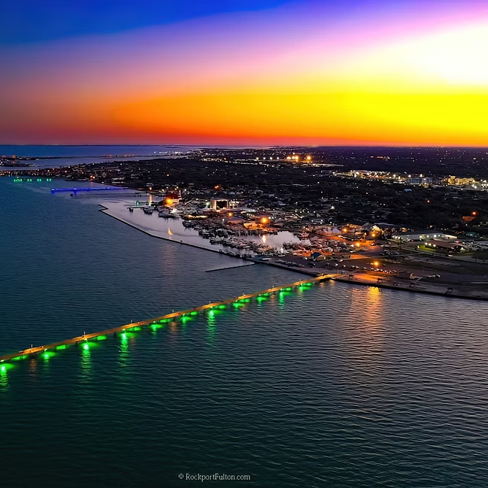
September 2025
Billed Utility Connections / Consumption
Water: 10,538 / 669,157.0000
Sewer: 5,698 / 364,587.0000
Gas: 4,650 / 66,503.0000
Public Works

Slide 8

Purchased Water
(San Patricio Municipal Water District)
FY2024-2025
Purchased Water (Gallons) / Billed
October: 111,629,000 / $392,934.08
November: 88,560,000 / $311,731.20
December: 91,548,000 / $322,248.96
January: 72,449,000 / $275,306.20
February: 61,204.000 / $232,575.20
March: 70,560,000 / $268,128.00
April: 72,300,000 / $274,740.00
May: 70,732,000 / $268,781.60
June: 65,573,000 / $249,177.40
July: 88,977,000 / $338,112.60
August: 78,626,000 / $298,778.80
September: 84,896,000 / $322,604.80
Fiscal Year Total: 957,054,000 / $3,55,118.84
Public Works

Slide 9

Residential/Commercial Water Usage
FY2024-2025
Water Usage (Gallons)
October: 71,202,200
November: 82,227,000
December: 65,928,500
January: 71,240,500
February: 50,818,300
March: 50,940,700
April: 63,493,100
May: 59,312,200
June: 65,034,400
July: 59,507,000
August: 71,758,700
September: 66,915,700
Public Works

Slide 10

POLICE DEPARTMENT​

Slide 11
August
 | 2024 | 2025
Police Incidents | 97 | 35
Calls for Service | 504 | 788
Arrests | 32 | 41
Traffic Contacts | 557 | 666
Traffic Accidents | 8 | 19
CID Cases Assigned | 65 | 57
CID Clearance Rate | 33% | 43%
POLICE DEPARTMENT​​

Slide 12


Slide 13
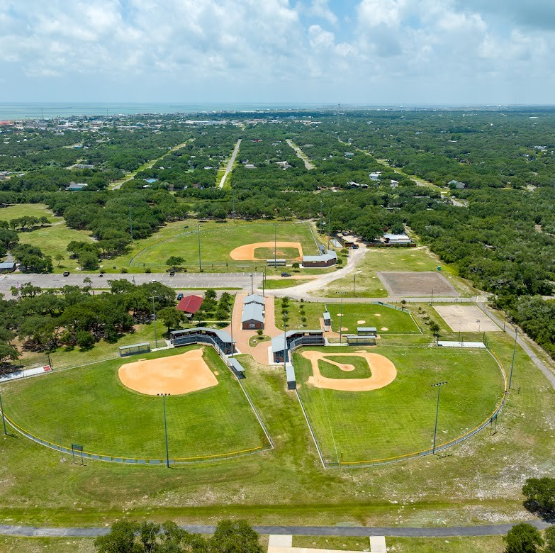
Rockport
Parks & Recreation​ Department
August Activities
Memorial Park Pavilion Rentals – 4
Field Rentals - 2
Private Swim Lessons – 1
Homeschool Group Swim Lessons – 8 Participants
Summer Swim camp Session 3 – 5 Participants
Pool Parties – 6 Table Rentals – 1
Parks/Pool Booths at Backpacks and Blue jeans, LOLC Meet The Teacher, FE Meet the Teacher, RFMS Meet the Teacher, RFHS Meet The Teacher
Hosted Inaugural First Responders Appreciation Swim Party

Slide 14
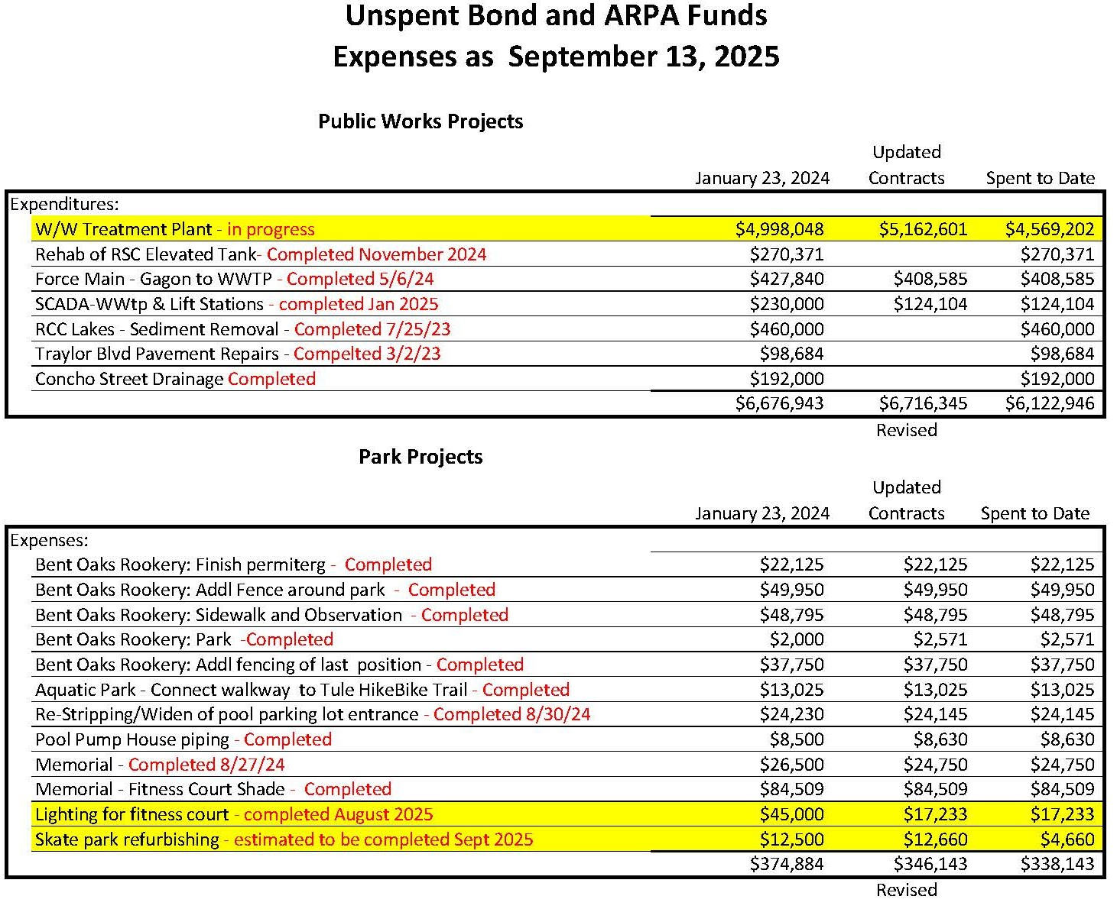
Unspent Bonds
Parks is finishing up their last project and reviewing for any remaining fund balance. Any fund balance will be brought back to Council for approval of future project(s).

Slide 15
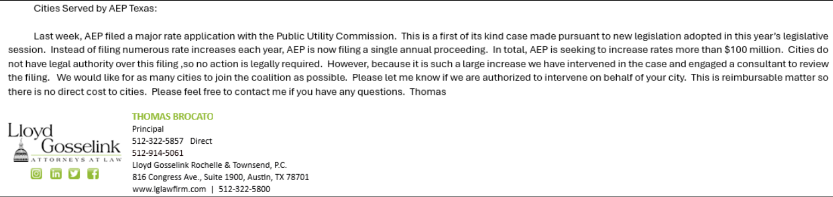

Slide 16
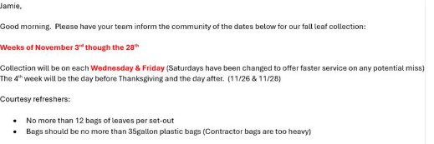

Slide 17
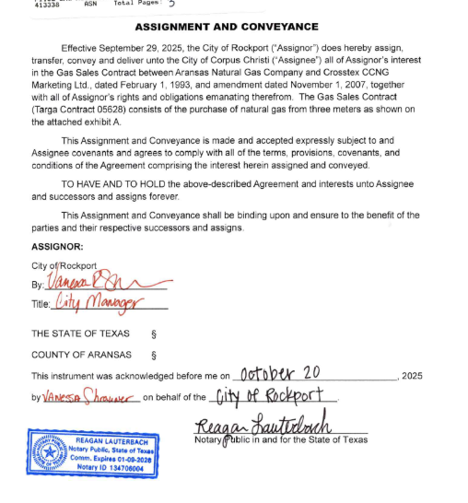

Slide 18
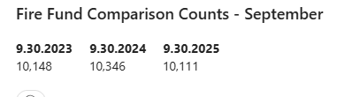

Slide 19
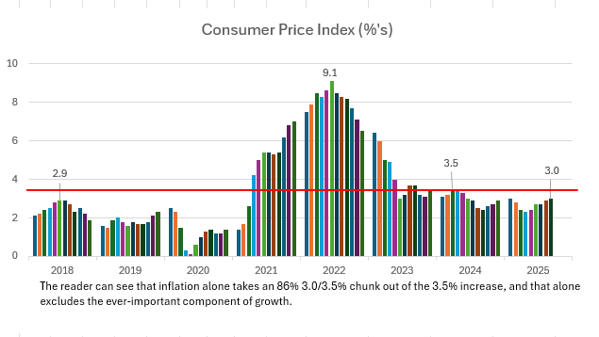

Slide 20
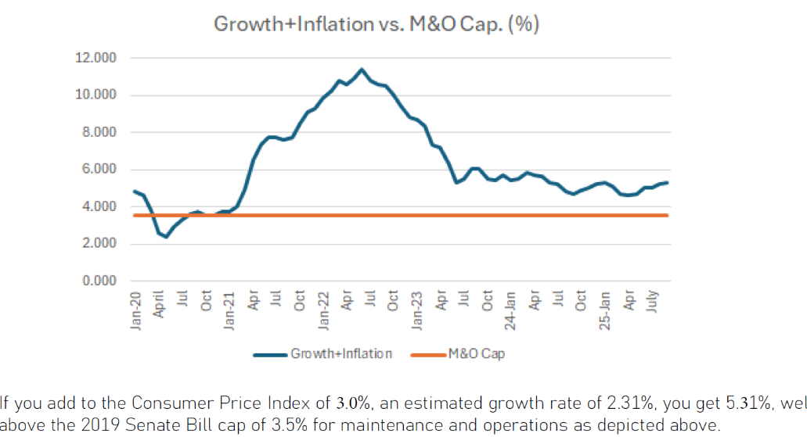

Slide 21
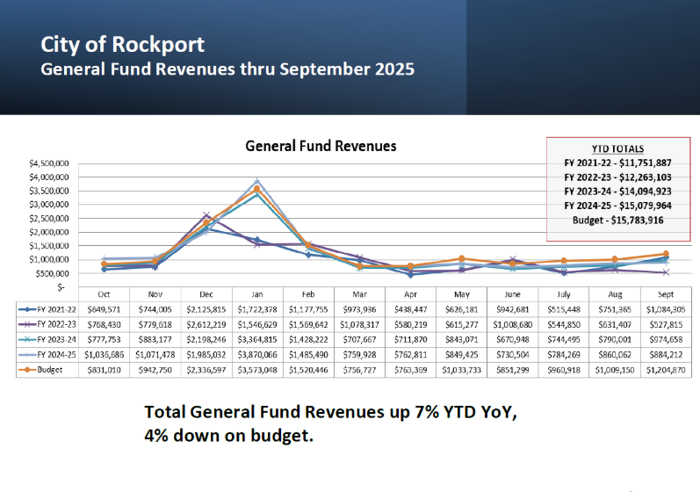

Slide 22
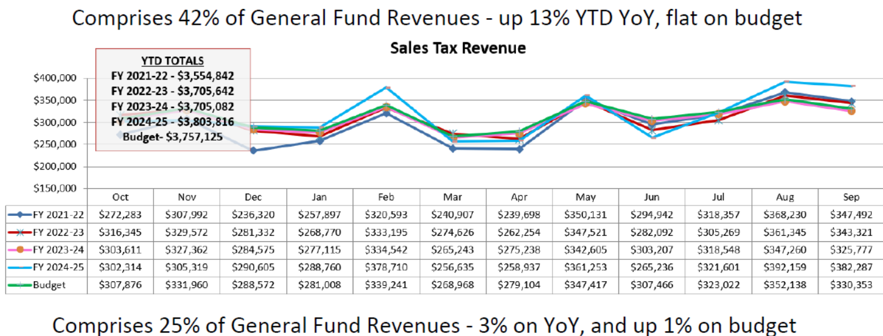

Slide 23
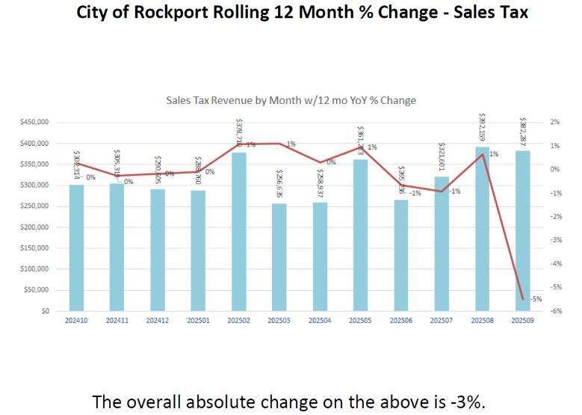

Slide 24
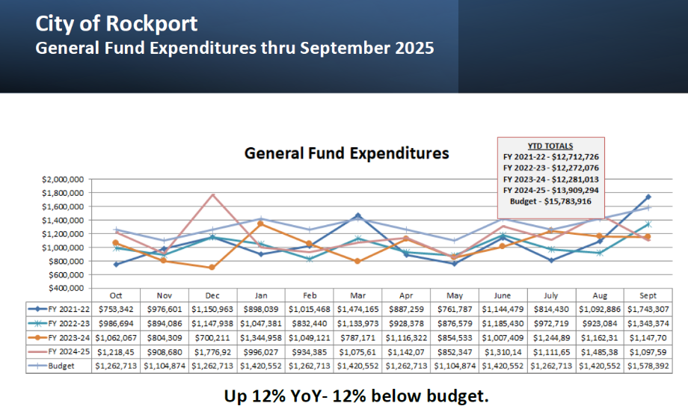

Slide 25
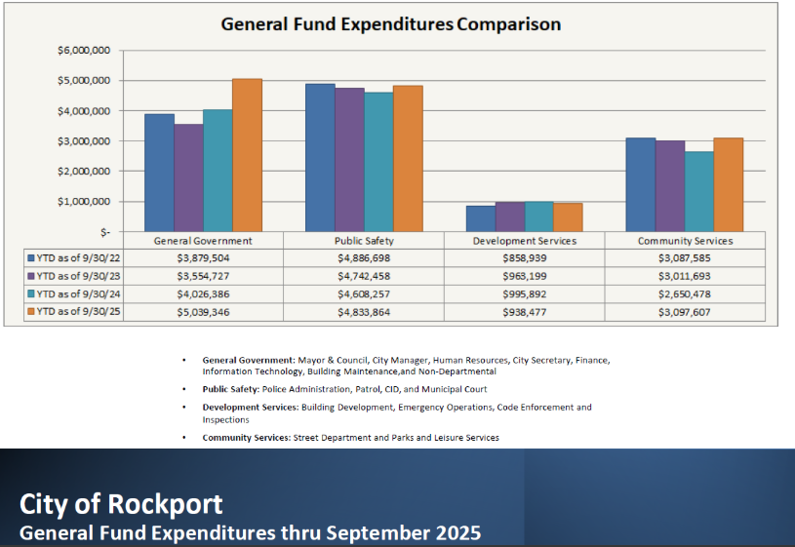

Slide 26
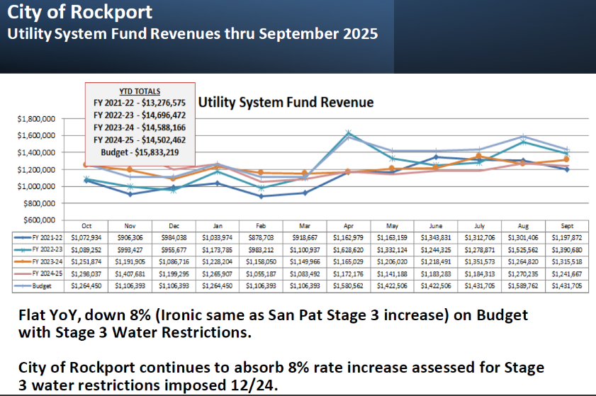

Slide 27
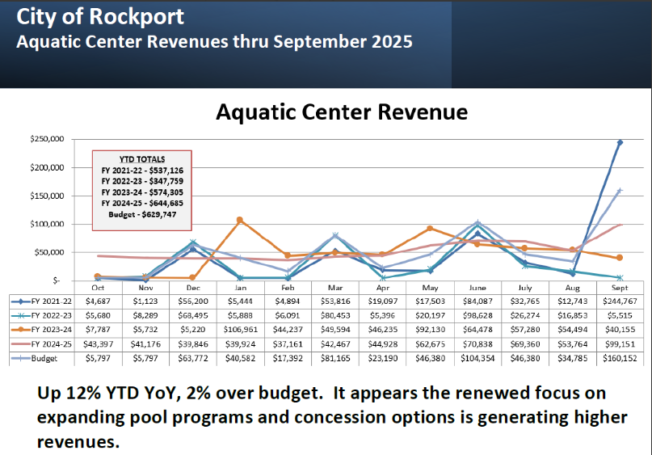

Slide 28
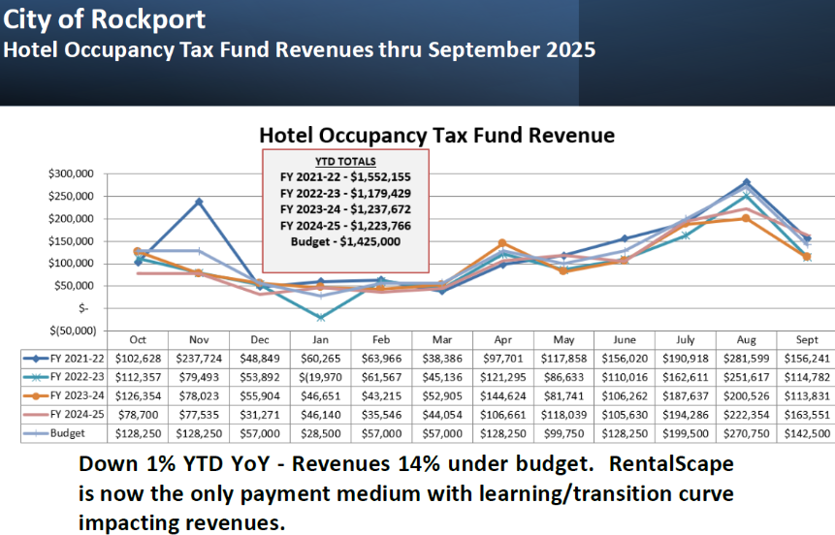

Slide 29
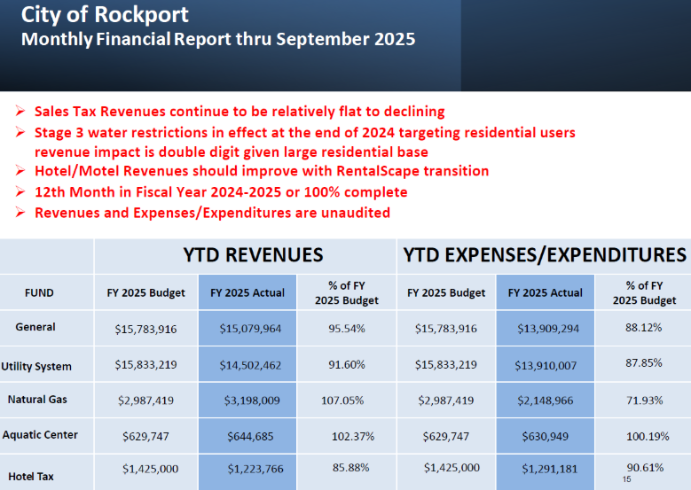

Slide 30
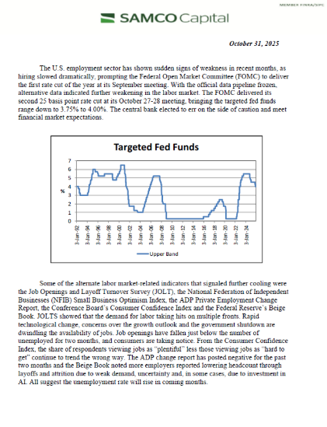

Slide 31
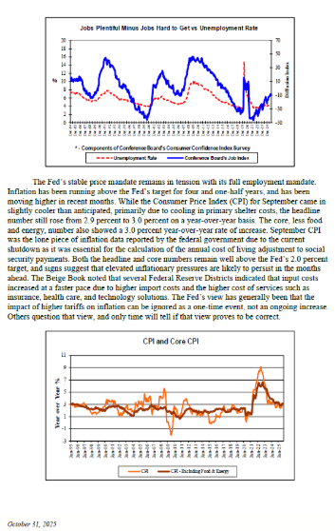

Slide 32
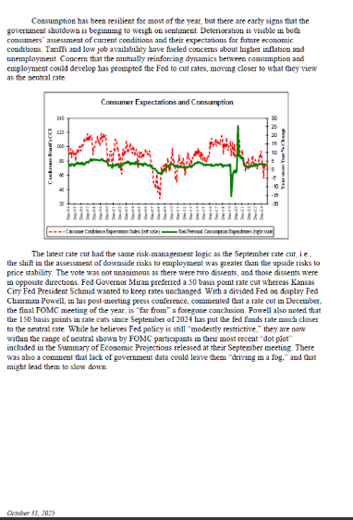

Slide 33
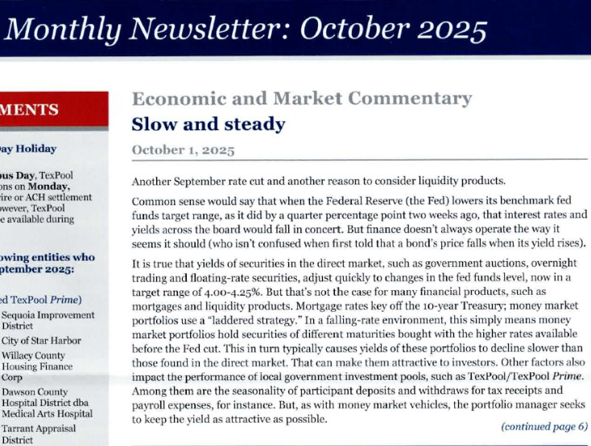

Slide 34
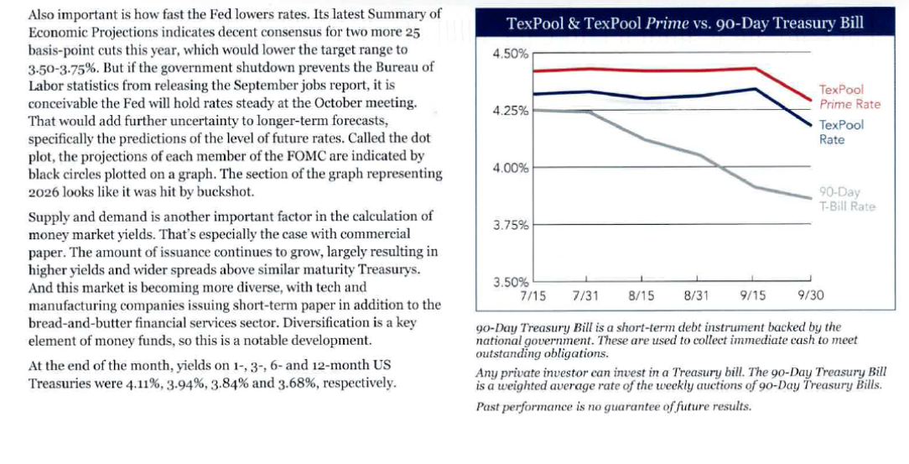

Slide 35

PUBLIC SAFETY COMMUNICATIONS MONTHLY NEWSLETTER CREATED BY SHIFT SUPERVISOR - CHELSI GODWIN

Slide 36

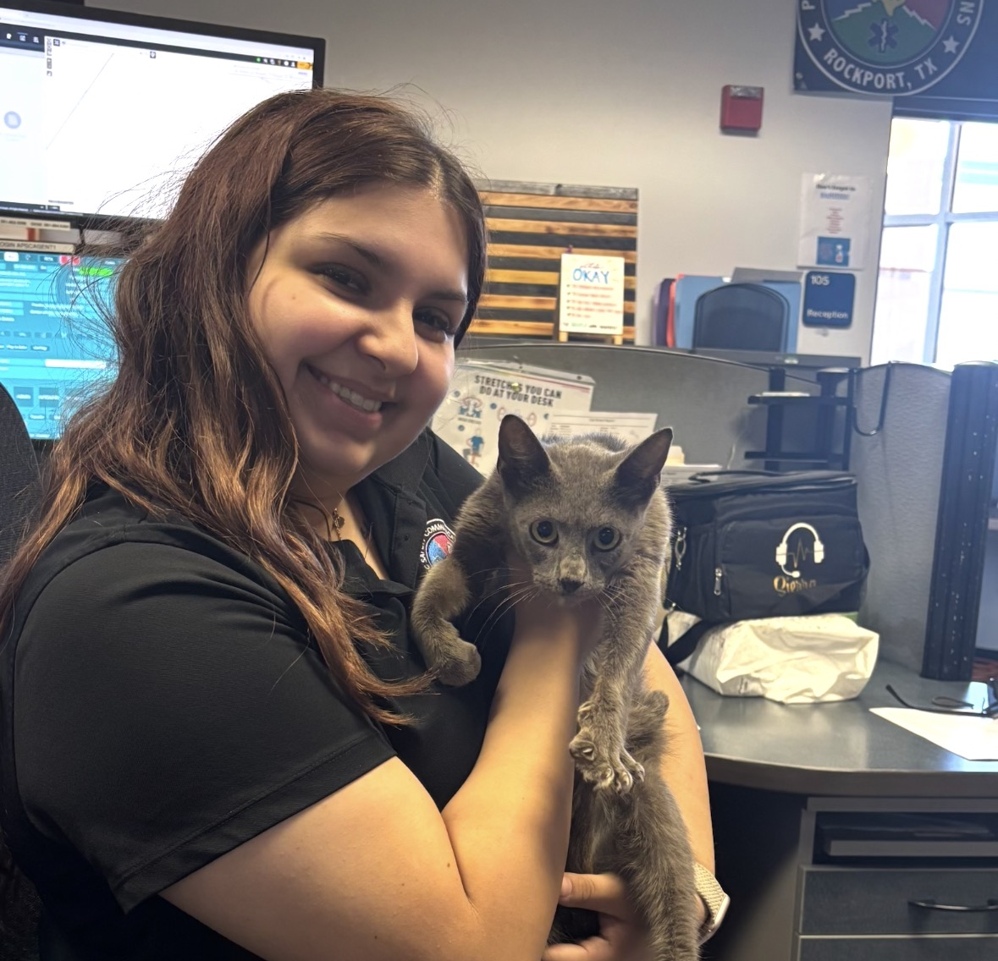
August 2025
Admin Phone Calls – 4,119
911 Calls – 1,551
Calls Dispatched – 2,285
Traffic Stops – 1,374
Launch of Reverse Alert – New Community Notification System
256 Training Hours by New Communications Officers
Updated Console Binders & After Hours On-Call Schedules
Comfort Friends visit from Animal Care Services

Slide 37
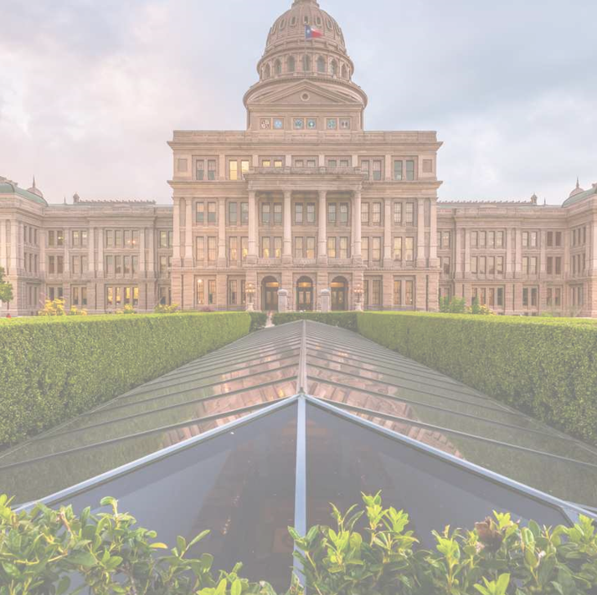
89th Legislative Session
248 City-related Bill passed
Governor Abbott Vetoed 5 City-related Bills
Not all 248 Bill pertain to Rockport
Staff has created a spreadsheet with effective dates and compliance date.

Slide 38
City Showcase – October 22, 2025
Where: Rockport Conference Center
Time: 5-6 Department Social
6 State of the City
Free Event – space is limited, stop by Administration Office at City Hall or Rockport Service Center for your ticket or you can reserve them online https://rockporttx.gov/FormCenter/City-Showcase-State-of-the-City-Reservat-12/City-Showcase-State-of-the-City-Reservat-62

Slide 39
Remaining City Council Regular Meetings
October 14, 2025
November 12, 2025 (Wednesday due to Holiday)
December 9, 2025
All Regular Meetings start at 5:00 p.m. unless noted and are held at City Hall in the Council Chambers.

